Slide 1
Woodlands CS Club
Number Theory
Group A
1/11/2021

Slide 2
Announcements
News regarding CCC and Euclid contests has changed meaning that the Woodlands can now host the contest. The registration should (if not already) be posted sometime during the next week. Make sure to register if you are interested in writing!

Slide 3
What is Number Theory?
Number theory is a branch of mathematics which studies the different properties of integers.
Number theory explores things such as factoring numbers, primes and divisibility.
This is useful in computer science as it has many useful applications and can be generalized using programming.

Slide 4
Definitions
Factor - a factor of n is an whole number which can be multiplied by some integer to produce n. In other words, if the factor is m, the remainder of n / m is 0. In computer science, this means that m is a factor of n if n%m==0.
Composite Number - a composite number is a number which has more than two factors. This can be expanded to saying that a number is composite if it can be produced by multiplying two smaller integers.
Prime Number - a prime number is a number which only has two factors, 1 and itself.* Extending off our definition for composite numbers, we can say that you cannot multiply any two smaller integers to form a prime number.
*Note that the integer 1 is neither prime nor composite.

Slide 5
Prime Numbers - Why Care?
There are infinitely many prime numbers, and they are used everywhere. As stated previously, prime numbers cannot be factored any further as they only have one proper divisor - 1. Every other whole number can be broken down into prime factors.
Eg. (12 = 2 * 2 * 3)
In other words, primes serve as the building blocks for all numbers. As factoring extremely large numbers is difficult, this serves as the basis for cryptography and encryption.

Slide 6
Problem 1:
Given an integer N, determine whether it is prime or not.

Slide 7
Solution 1: O(N)
Iterate from 2 to N-1 and check if any number is a factor of N. If it is, then N is composite.
Eg:
Remember that the integer 1 is an edge case.
Can we do better than O(N) though?
def isPrime(n):
for i in range(2,n):
if(n%i==0):
return False
return True

Slide 8
Solution 2: O(sqrt(N))
It turns out we can improve our time complexity! Instead of looping from 2 to N-1, we can instead loop from 2 to sqrt(N).
Why?
Note that it is typically better to check whether i * i is <= N instead of checking whether i <= sqrt(N) in order to avoid floating point inaccuracies.
N = a * b
It is impossible for both a and b to be greater than sqrt(N) because sqrt(N) * sqrt(N) = N and anything larger would be greater than N. Thus, if a * b = N at least one factor has to be smaller or equal to the square root of N, and we will check for it while iterating up to sqrt(N).

Slide 9
O(sqrt(N)) Prime Check Code
bool isPrime(int n){
if(n <= 1) return false;
for(int i = 2; i * i <= n; i++) {
if(n % i == 0) return false;
}
return true;
}

Slide 10
Problem 2: Checking Primes in a Range
Problem Link: https://dmoj.ca/problem/phantom1
TL;DR: Output the number of primes in the range [a, b) for N different test cases
N <= 10
a <= b <= 500

Slide 11
Solution: O(Nsqrt(N)) or O(N^2)
#include <bits/stdc++.h>
using namespace std;
bool isPrime(int n){
if(n <= 1) return false;
for(int i = 2; i * i <= n; i++) {
if(n % i == 0) return false;
}
return true;
}
int main() {
int n; cin >> n;
for(int i = 1; i <= n; i++) {
int a, b, ans = 0; cin >> a >> b;
for(int i = a; i < b; ++i) {
if(isPrime(i)) ans++;
}
cout << cnt << '\n';
}
}
Since the bounds on N, a and b are all extremely small, we can just iterate from a to b-1 and check whether the number is prime. In fact, even without our square root optimization, we can still AC.

Slide 12
Problem 2.5: Checking Primes in a Range
Problem Link: https://dmoj.ca/problem/phantom2
TL;DR: Output the number of primes in the range [a, b) for N different test cases
N <= 20
a <= b <= 1000000

Slide 13
Solution: O(Nsqrt(N))
Our old solution will TLE!
Our algorithm is too slow to count the number of primes in a range. Can we do better?

Slide 14
Sieve Of Eratosthenes
Space: O(N)
Time Complexity: O(N log(log N))
The sieve of Eratosthenes is a boolean array which will be true if a number is composite and false if a number is prime. The algorithm for computing this array is extremely efficient.
Note that although the O(Nsqrt(N)) method is slower, it has O(1) memory whereas sieve uses O(N) memory.

Slide 15
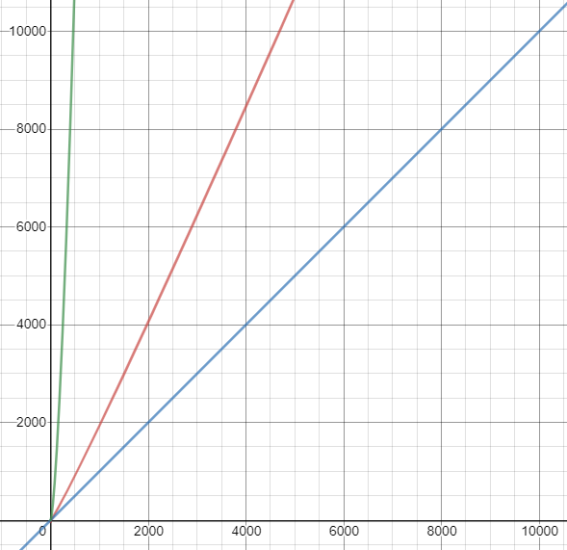
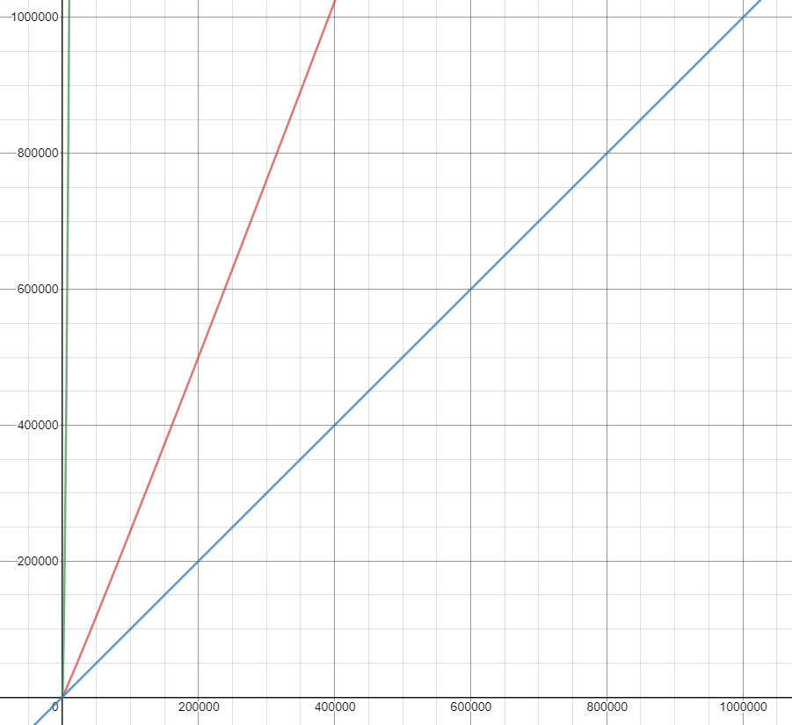
N <= 10000
N <= 1000000

Slide 16
Sieve Of Eratosthenes - How does it work?
If sieve[i] is false, then i is prime, and if sieve[i] is true, then i is composite.
We start by initializing a boolean array of N+1 size to false. We set 1 to true because 1 is not prime (although it is also not composite). The algorithm for building the sieve is as follows:
We then loop from 2 → N: if the number we are at is false (sieve[i] is false) that means it is prime. As a result, we loop through the multiples of i and set them all to true, because any multiples of this number are definitely not prime.

Slide 17
Sieve Demo: N = 20
= false
= true
1 | 2 | 3 | 4 | 5 | 6 | 7 | 8 | 9 | 10 | 11 | 12 | 13 | 14 | 15 | 16 | 17 | 18 | 19 | 20
Step: Create a boolean array which is initialized to false

Slide 18
Sieve Demo: N = 20
= false
= true
1 | 2 | 3 | 4 | 5 | 6 | 7 | 8 | 9 | 10 | 11 | 12 | 13 | 14 | 15 | 16 | 17 | 18 | 19 | 20
Step: Set 1 to true (not prime)

Slide 19
Sieve Demo: N = 20
= false
= true
1 | 2 | 3 | 4 | 5 | 6 | 7 | 8 | 9 | 10 | 11 | 12 | 13 | 14 | 15 | 16 | 17 | 18 | 19 | 20
Step: Loop from 2 → N
Current Index in Loop: 2
Is 2 false? Yes

Slide 20
Sieve Demo: N = 20
= false
= true
1 | 2 | 3 | 4 | 5 | 6 | 7 | 8 | 9 | 10 | 11 | 12 | 13 | 14 | 15 | 16 | 17 | 18 | 19 | 20
Step: Loop through all multiples of 2 and mark them as true

Slide 21
Sieve Demo: N = 20
= false
= true
1 | 2 | 3 | 4 | 5 | 6 | 7 | 8 | 9 | 10 | 11 | 12 | 13 | 14 | 15 | 16 | 17 | 18 | 19 | 20
Step: Loop from 2 → N
Current Index in Loop: 3
Is 3 false? Yes

Slide 22
Sieve Demo: N = 20
= false
= true
1 | 2 | 3 | 4 | 5 | 6 | 7 | 8 | 9 | 10 | 11 | 12 | 13 | 14 | 15 | 16 | 17 | 18 | 19 | 20
Step: Loop through all multiples of 3 and mark them as true

Slide 23
Sieve Demo: N = 20
= false
= true
1 | 2 | 3 | 4 | 5 | 6 | 7 | 8 | 9 | 10 | 11 | 12 | 13 | 14 | 15 | 16 | 17 | 18 | 19 | 20
Step: Loop from 2 → N
Current Index in Loop: 4
Is 4 false? No

Slide 24
Sieve Demo: N = 20
= false
= true
1 | 2 | 3 | 4 | 5 | 6 | 7 | 8 | 9 | 10 | 11 | 12 | 13 | 14 | 15 | 16 | 17 | 18 | 19 | 20
Step: Loop from 2 → N
Current Index in Loop: 5
Is 5 false? Yes

Slide 25
Sieve Demo: N = 20
= false
= true
1 | 2 | 3 | 4 | 5 | 6 | 7 | 8 | 9 | 10 | 11 | 12 | 13 | 14 | 15 | 16 | 17 | 18 | 19 | 20
Step: Loop through all multiples of 5 and mark them as true

Slide 26
Sieve Demo: N = 20
= false
= true
1 | 2 | 3 | 4 | 5 | 6 | 7 | 8 | 9 | 10 | 11 | 12 | 13 | 14 | 15 | 16 | 17 | 18 | 19 | 20
Step: Loop from 2 → N
Current Index in Loop: 6
Is 6 false? No

Slide 27
Sieve Demo: N = 20
= false
= true
1 | 2 | 3 | 4 | 5 | 6 | 7 | 8 | 9 | 10 | 11 | 12 | 13 | 14 | 15 | 16 | 17 | 18 | 19 | 20
Step: Loop from 2 → N
Current Index in Loop: 7
Is 7 false? Yes

Slide 28
Sieve Demo: N = 20
= false
= true
1 | 2 | 3 | 4 | 5 | 6 | 7 | 8 | 9 | 10 | 11 | 12 | 13 | 14 | 15 | 16 | 17 | 18 | 19 | 20
Step: Loop through all multiples of 7 and mark them as true

Slide 29
Sieve Demo: N = 20
= false
= true
1 | 2 | 3 | 4 | 5 | 6 | 7 | 8 | 9 | 10 | 11 | 12 | 13 | 14 | 15 | 16 | 17 | 18 | 19 | 20
Step: Loop from 2 → N
Current Index in Loop: 8
Is 8 false? No

Slide 30
Sieve Demo: N = 20
= false
= true
1 | 2 | 3 | 4 | 5 | 6 | 7 | 8 | 9 | 10 | 11 | 12 | 13 | 14 | 15 | 16 | 17 | 18 | 19 | 20
Step: Loop from 2 → N
Current Index in Loop: 9
Is 9 false? No

Slide 31
Sieve Demo: N = 20
= false
= true
1 | 2 | 3 | 4 | 5 | 6 | 7 | 8 | 9 | 10 | 11 | 12 | 13 | 14 | 15 | 16 | 17 | 18 | 19 | 20
Step: Loop from 2 → N
Current Index in Loop: 10
Is 10 false? No

Slide 32
Sieve Demo: N = 20
= false
= true
1 | 2 | 3 | 4 | 5 | 6 | 7 | 8 | 9 | 10 | 11 | 12 | 13 | 14 | 15 | 16 | 17 | 18 | 19 | 20
Step: Loop from 2 → N
Current Index in Loop: 11
Is 11 false? Yes

Slide 33
Sieve Demo: N = 20
= false
= true
1 | 2 | 3 | 4 | 5 | 6 | 7 | 8 | 9 | 10 | 11 | 12 | 13 | 14 | 15 | 16 | 17 | 18 | 19 | 20
Step: Loop through all multiples of 11 and mark them as true

Slide 34
Sieve Demo: N = 20
= false
= true
1 | 2 | 3 | 4 | 5 | 6 | 7 | 8 | 9 | 10 | 11 | 12 | 13 | 14 | 15 | 16 | 17 | 18 | 19 | 20
Step: Loop from 2 → N
Current Index in Loop: 12
Is 12 false? No

Slide 35
Sieve Demo: N = 20
= false
= true
1 | 2 | 3 | 4 | 5 | 6 | 7 | 8 | 9 | 10 | 11 | 12 | 13 | 14 | 15 | 16 | 17 | 18 | 19 | 20
Step: Loop from 2 → N
Current Index in Loop: 13
Is 13 false? Yes

Slide 36
Sieve Demo: N = 20
= false
= true
1 | 2 | 3 | 4 | 5 | 6 | 7 | 8 | 9 | 10 | 11 | 12 | 13 | 14 | 15 | 16 | 17 | 18 | 19 | 20
Step: Loop through all multiples of 11 and mark them as true
The loop would go up to 20, but to prevent repetition the demonstration will terminate here.

Slide 37
Sieve Demo: N = 20
= false
= true
1 | 2 | 3 | 4 | 5 | 6 | 7 | 8 | 9 | 10 | 11 | 12 | 13 | 14 | 15 | 16 | 17 | 18 | 19 | 20
At the end of our algorithm, we can see that the prime numbers <= 20 are: 2, 3, 5, 7, 11, 13, 17, 19

Slide 38
Sieve Code:
C++
Python
void buildSieve(int n){
bool sieve[n+1];
for(int i = 0; i <= n; i++) sieve[i] = false;
sieve[1] = true;
for(int i = 2; i <= n; i++) {
if(sieve[i] == false) {
for(int j = 2 * i; j <= n; j += i) {
sieve[j] = true;
}
}
}
}
def buildSieve(n):
sieve = [False for i in range(n+1)]
sieve[1] = True
for i in range(2, n+1):
if(sieve[i] == False):
for j in range(2*i, n+1, i):
sieve[j] = True
return sieve

Slide 39
Sieve Optimizations
Sieve can be constructed in O(N) time as well.
Some constant optimizations:
First for loop can iterate from 2 → sqrt(N) using the same reasoning as the prime testing
The second for loop can iterate from i^2 instead of 2 * i
Using sieve, we can solve: https://dmoj.ca/problem/phantom2
An extension of sieve is “segmented sieve” which can used to solve: https://dmoj.ca/problem/phantom3

Slide 40
Problem 3:
The general idea behind sieve can be extended to other number theory topics as well. In particular, a similar method can be used for precomputing factors.
This next problem appeared on the Canadian Computing Contest last year in both the senior and junior division (Senior Problem 2, Junior Problem 5), and is solvable using topics we have already learned in previous meetings.
Problem Link: https://dmoj.ca/problem/ccc20s2

Slide 41
Problem Statement:
Given an M x N grid with each cell containing an integer value compute if it is possible to get from (1, 1) to (M, N). If you are in a cell containing the value x, you can move to any cell (a, b) which satisfies a * b = x, as long as both a and b are within the grid.
Eg. If the value of the cell is 6, you can move to (2, 3), (3, 2), (1, 6) or (6, 1)

Slide 42
Solution:
We can use a graph traversal algorithm we learned to traverse the graph and check if it is possible to reach the end.
Eg. We could run a BFS, and then once we reach a cell, we can compute the factors of the cell’s value and then traverse those cells as long as they are within our graph.
Many people exceeded the time limit on the final subtask of this problem using this solution.
It appears that it was slightly too slow for most participants to score 15/15.
Can we improve this solution?

Slide 43
Solution Optimization
We discover that instead of computing the factors in an online matter, or in the BFS when we reach a cell, we can compute the factors of all numbers before we run the BFS.
To precompute the factors of all numbers we can use a similar formula to a sieve.
We loop from 1 → maxN where maxN is the largest cell value in the grid. This loop will represent the factor. We can then loop through the multiples of this factor and insert it into a list which will hold the factors for each number. In other words, moves[i] contains all the factors of i.
Eg.
vector<pair<int, int>> moves[maxN];
for(int i = 1; i <= maxN; i++) {
for(int m = i; m <= maxN; m += i) {
moves[m].push_back({i, m/i});
}
}

Slide 44
Problems (Sorted by Difficulty):
https://dmoj.ca/problem/bf3 - Next Prime
https://dmoj.ca/problem/ccc19s2 - CCC '19 S2 - Pretty Average Primes
https://dmoj.ca/problem/fhc15c1p1 - Homework
https://dmoj.ca/problem/dmopc14c3p4 - DMOPC '14 Contest 3 P4 - Not Enough Testers!
The last problem also requires a topic we have learned previously.

